Slide 1
Variational Auto-Encoder

Slide 2
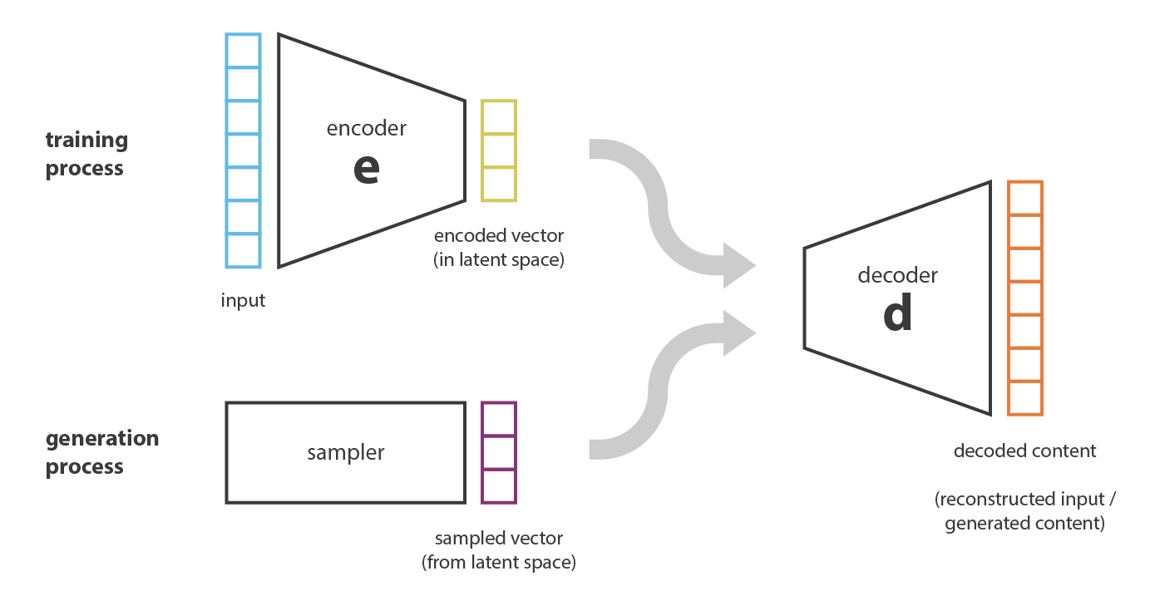
paper: Auto-Encoding Variational Bayes
Kingma et al.

Slide 3
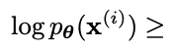
paper: Auto-Encoding Variational Bayes
Using MLE optimizing ELBO(Evidence of Lower Bound) term.
Regularization Parameter
Reconstruction term
ELBO

Slide 4
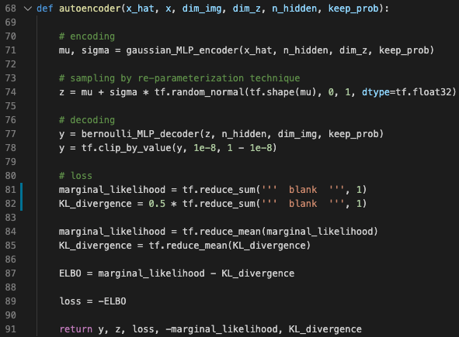
se_tutorials/vae/vae.py
Reconstruction Error
x*log(decode(encode(x))
+ (1-x)*log(1-decode(encode(x))
input
Regularization Parameter
0.5 * (mu_z^2 + sigma_z^2 – log(sigma_z) -1)
Encoded vector
Decoded output

Slide 5
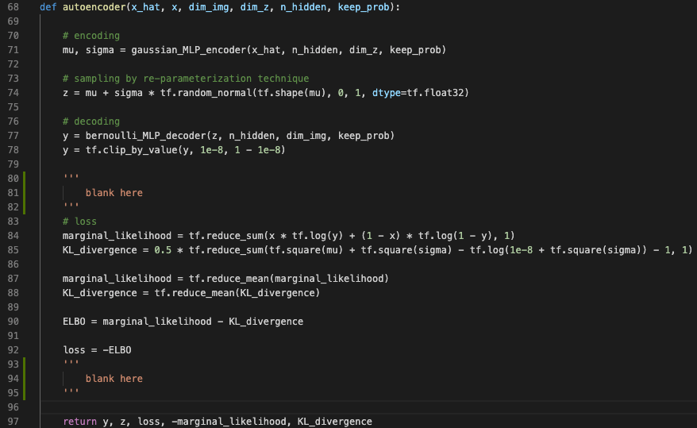
se_tutorials/vae/vae.py (answer)

Slide 6
Deep Convolutional GAN

Slide 7

paper: Generative Adversarial Nets
Goodfellow et al.
Adversarially train generator(G) and Discriminator(D).
https://pathmind.com/kr/wiki/generative-adversarial-network-gan

Slide 8
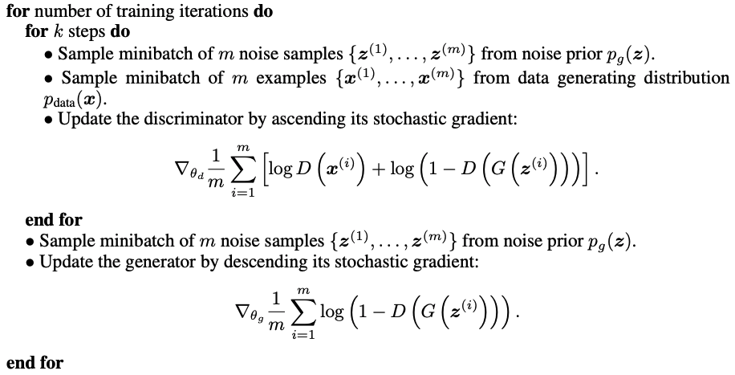
paper: Generative Adversarial Nets
Goodfellow et al.
Discriminator Loss
Generator Loss
The original GAN paper notes that the above minimax loss function can cause the GAN to get stuck in the early stages of GAN training when the discriminator's job is very easy. The paper therefore suggests modifying the generator loss so that the generator tries to maximize log D(G(z)).

Slide 9
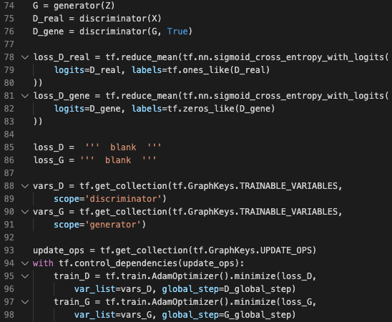
se_tutorials/dcgan/dcgan.py
= reduce_sum(log(D_real))
= reduce_sum(log(D_gene))
Discriminator Loss
Generator Loss

Slide 10
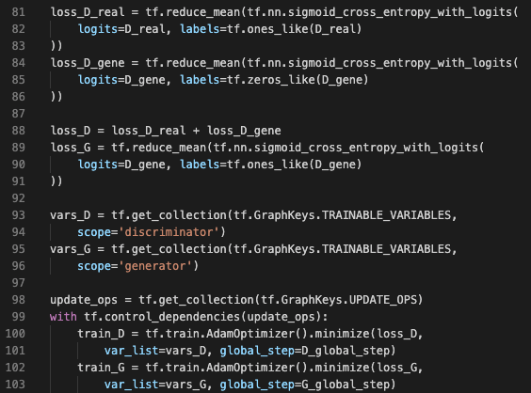
se_tutorials/dcgan/dcgan.py (answer)

Slide 11
pix2pix

Slide 12
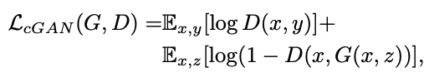
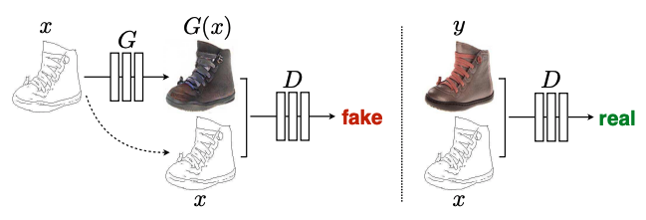
paper: Image-to-Image Translation with Conditional Adversarial Networks
Isola et al.
Conditional GAN (cGAN)

Slide 13
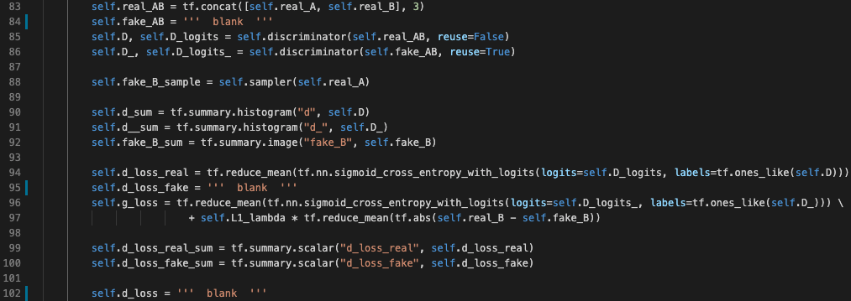
se_tutorials/pix2pix/model.py
Concat A(x) and B(y) to implement D(x, y)

Slide 14
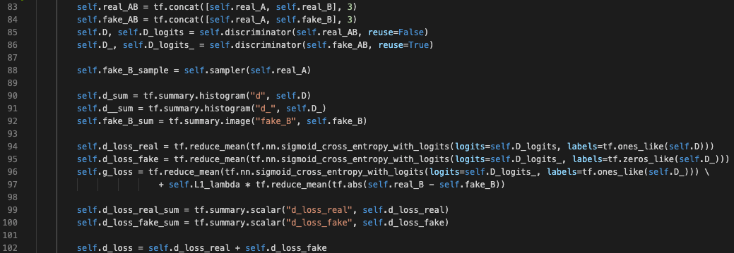
se_tutorials/pix2pix/model.py (answer)

Slide 15
CycleGAN

Slide 16
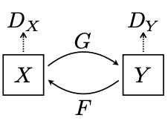
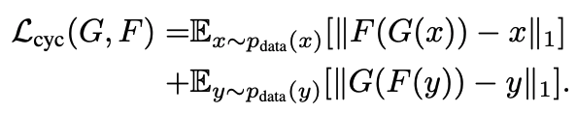
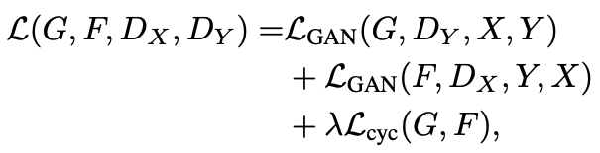
paper: Unpaired Image-to-Image Translation using Cycle-Consistent Adversarial Networks
Zhu et al.
CycleGAN => Cycle Consistency Loss
Full Loss

Slide 17
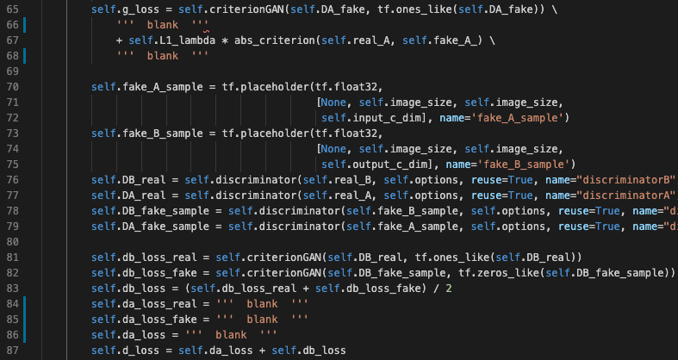
se_tutorials/cyclegan/model.py
Cycle Consistency Loss

Slide 18
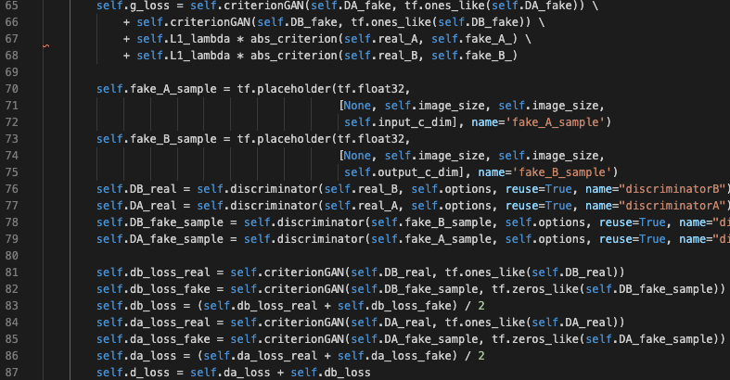
se_tutorials/cyclegan/model.py (answer)

Slide 19
SRGAN

Slide 20
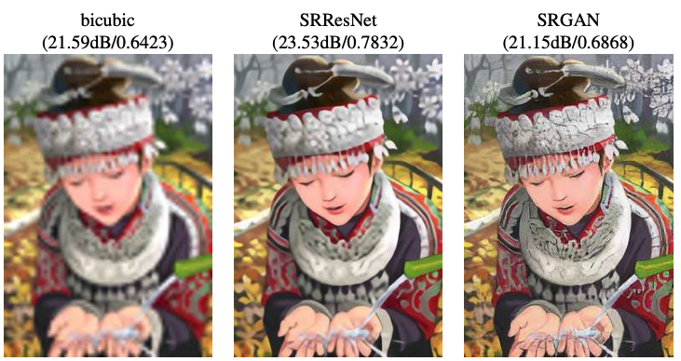
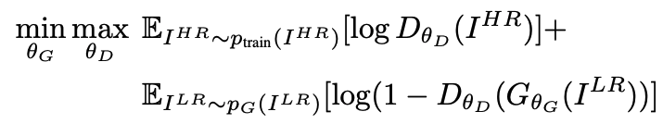
paper: Photo-realistic single image super-resolution using a generative adversarial network
Ledig et al.
Train an SR network(Generator) using GAN algorithm.

Slide 21
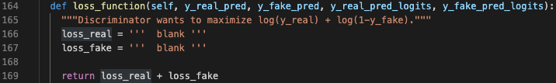
se_tutorials/srgan/srgan.py
Inside Generator class
Inside Discriminator class

Slide 22
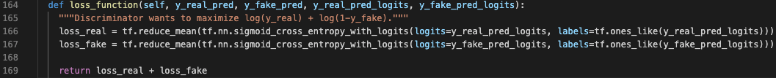
se_tutorials/srgan/srgan.py (answer)
Inside Generator class
Inside Discriminator class

Slide 23
Meta-Learning

Slide 24
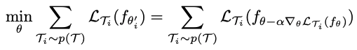
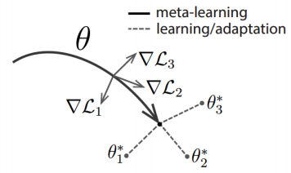
paper: Model-Agnostic Meta-Learning
Finn et al.
Goal: Train the model’s initial parameters such that the model has maximal performance on a new task after few-shot learning.

Slide 25
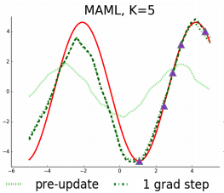
task: Few-Shot Learning (sinusoid regression)
Regressing a random sinusoidal function given some data points
given data points
red: target sinusoid
green dot: regressed function
before update

Slide 26
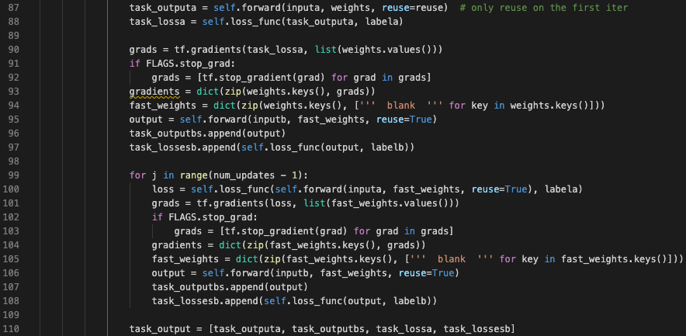
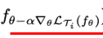
se_tutorials/meta-learning/maml.py (answer)

Slide 27
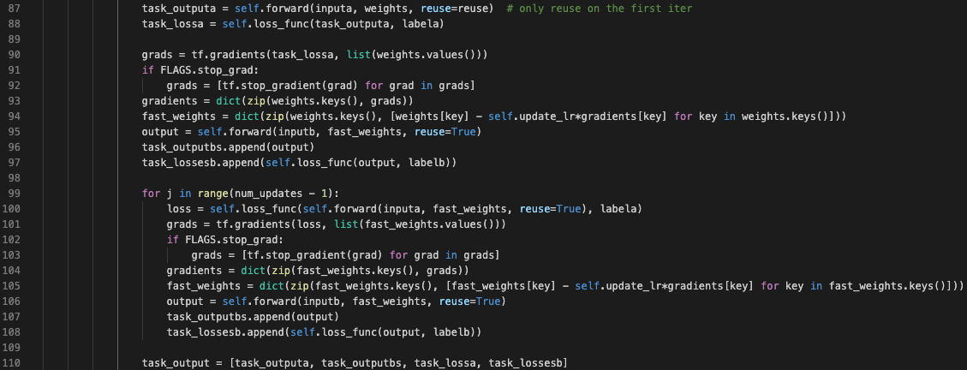
se_tutorials/meta-learning/maml.py (answer)

Slide 28
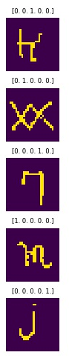
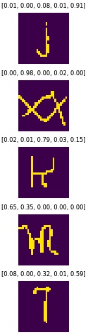
task: Few-Shot Learning (Omniglot classification)
Omniglot is a dataset of different characters.
Given K datapoints of with N classes, we want the network to be able to distinguish new data.
We call this N-way K-shot classification

Slide 29
First Order Approximation of MAML
MAML training requires high-order derivatives with respect to the network parameters, which takes long time.
Evaluate this gradient at training time, so that there are no higher-order derivatives to compute when computing gradients of the loss.

Slide 30
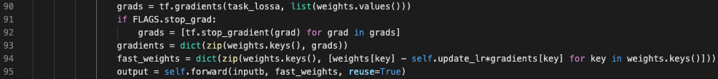
First Order Approximation of MAML
Evaluate this gradient at training time, so that there are no higher-order derivatives to compute when computing gradients of the loss.

